Slide 1
Images for PhD Research
9/16/2016

Slide 2
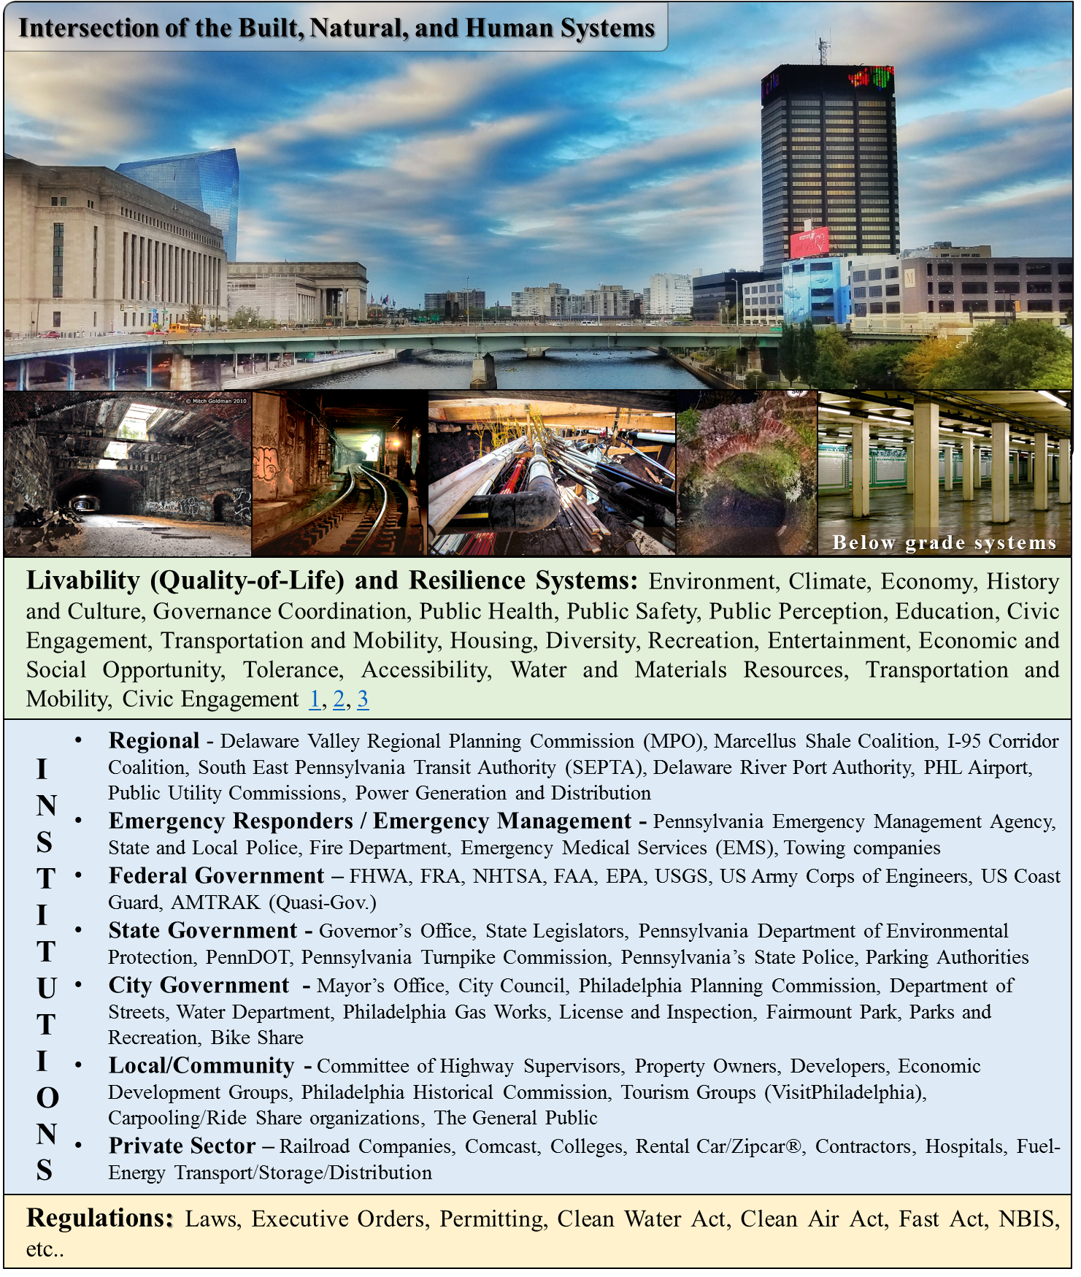



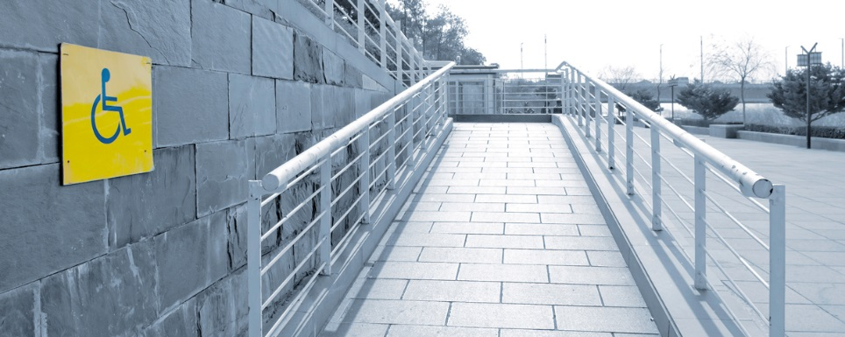


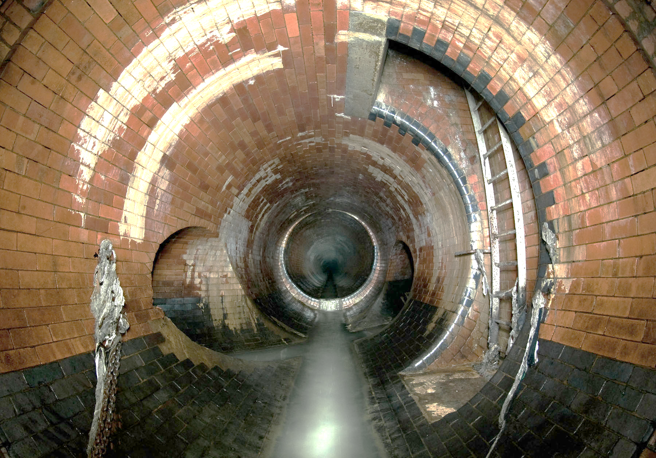
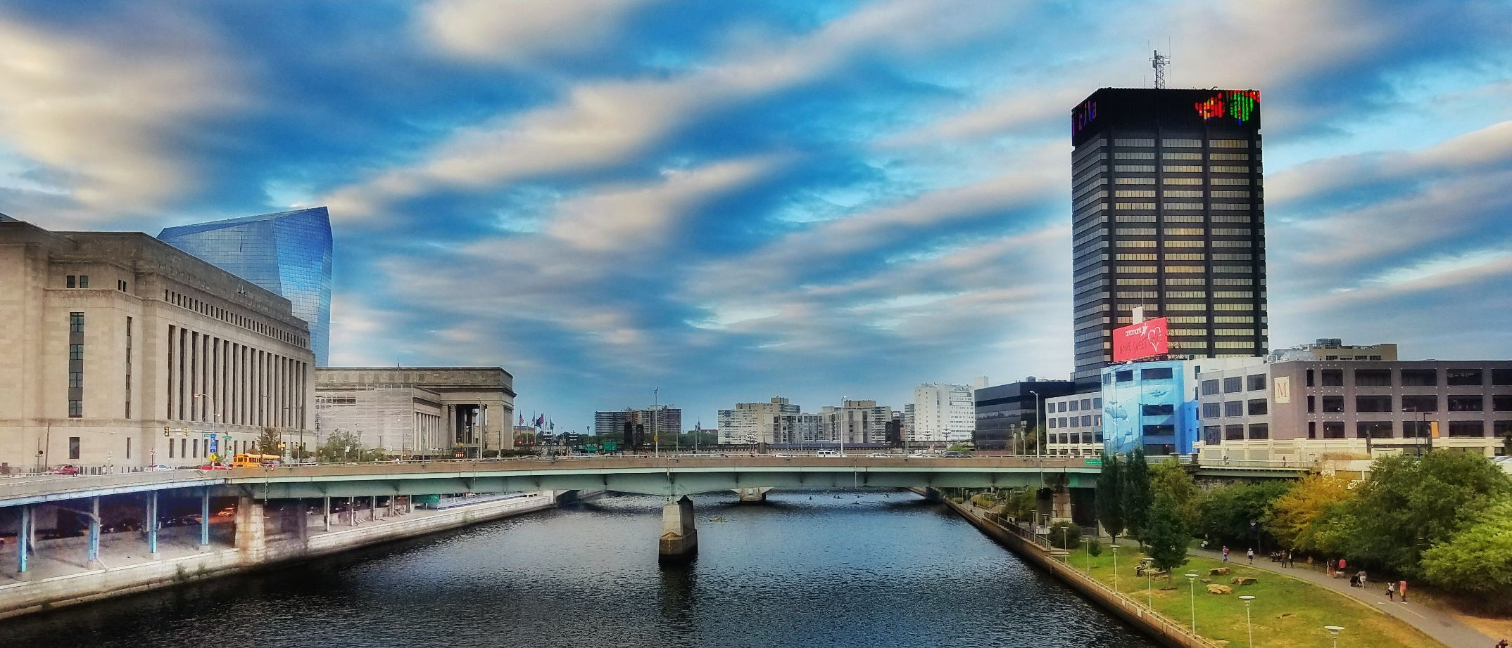
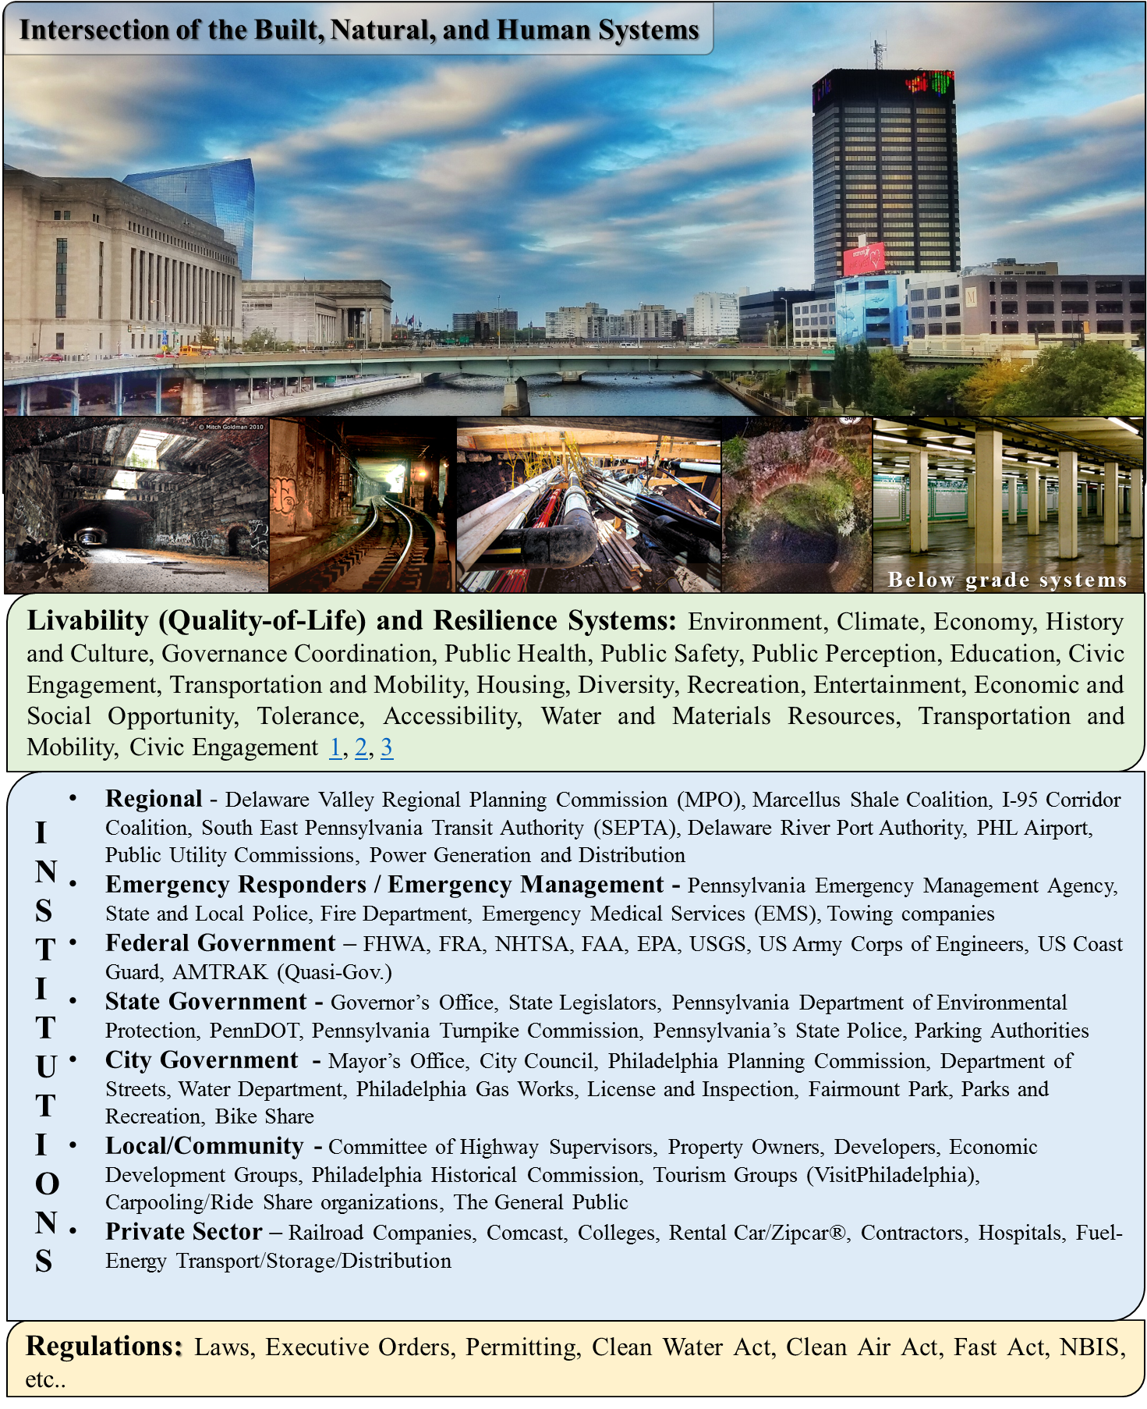
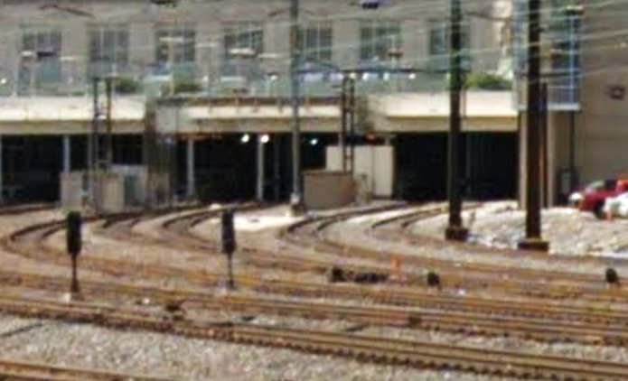
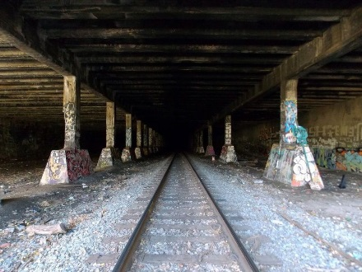
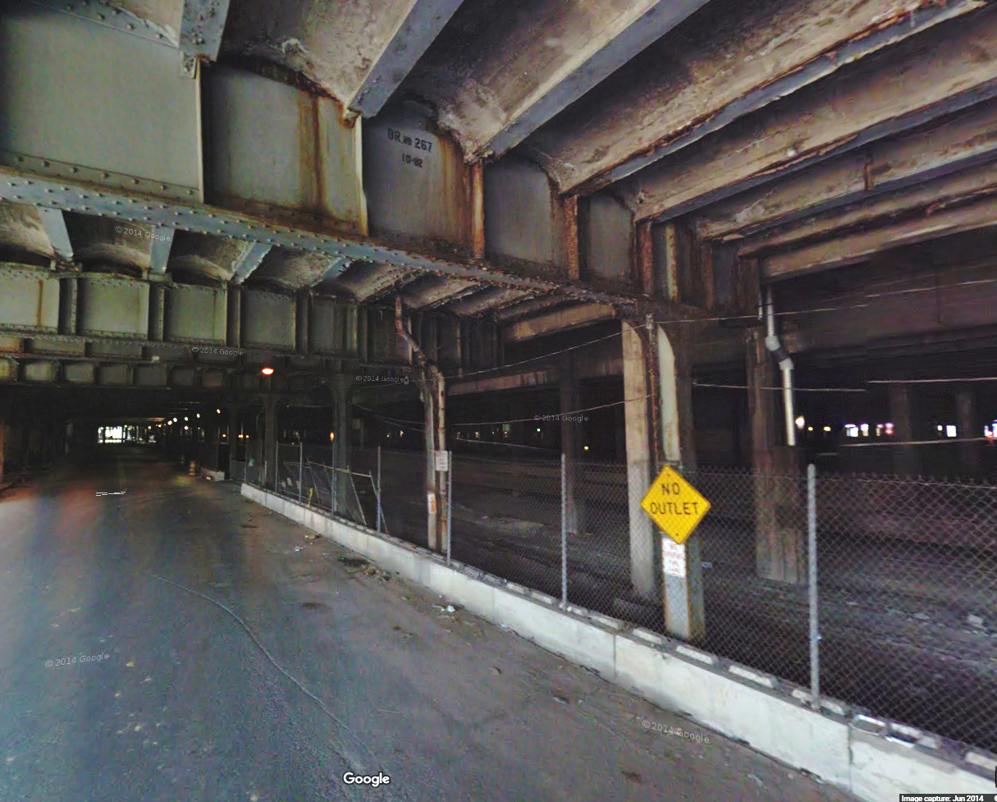
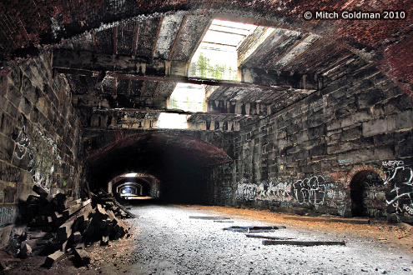
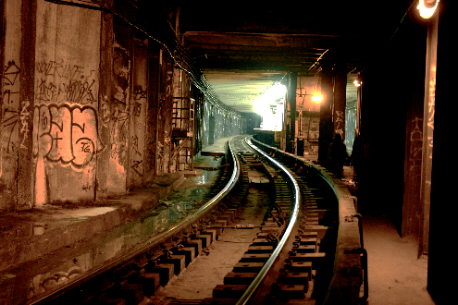
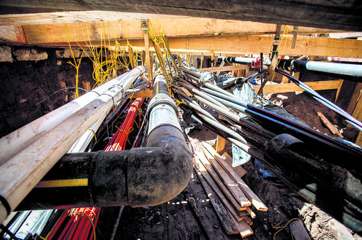
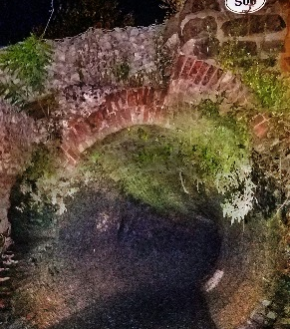
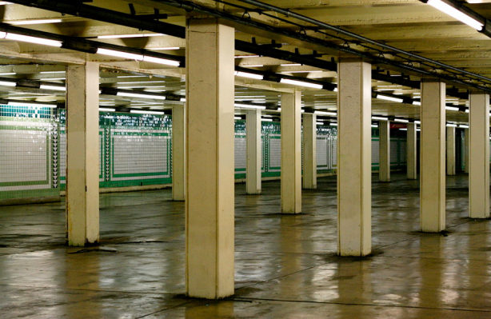
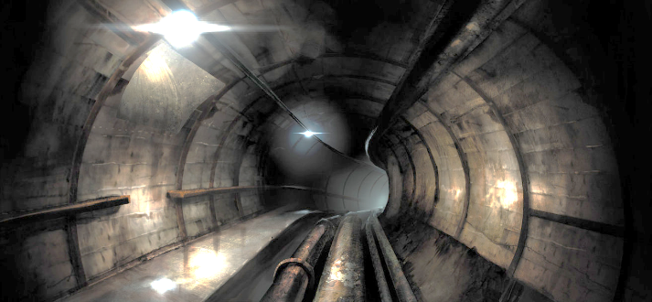
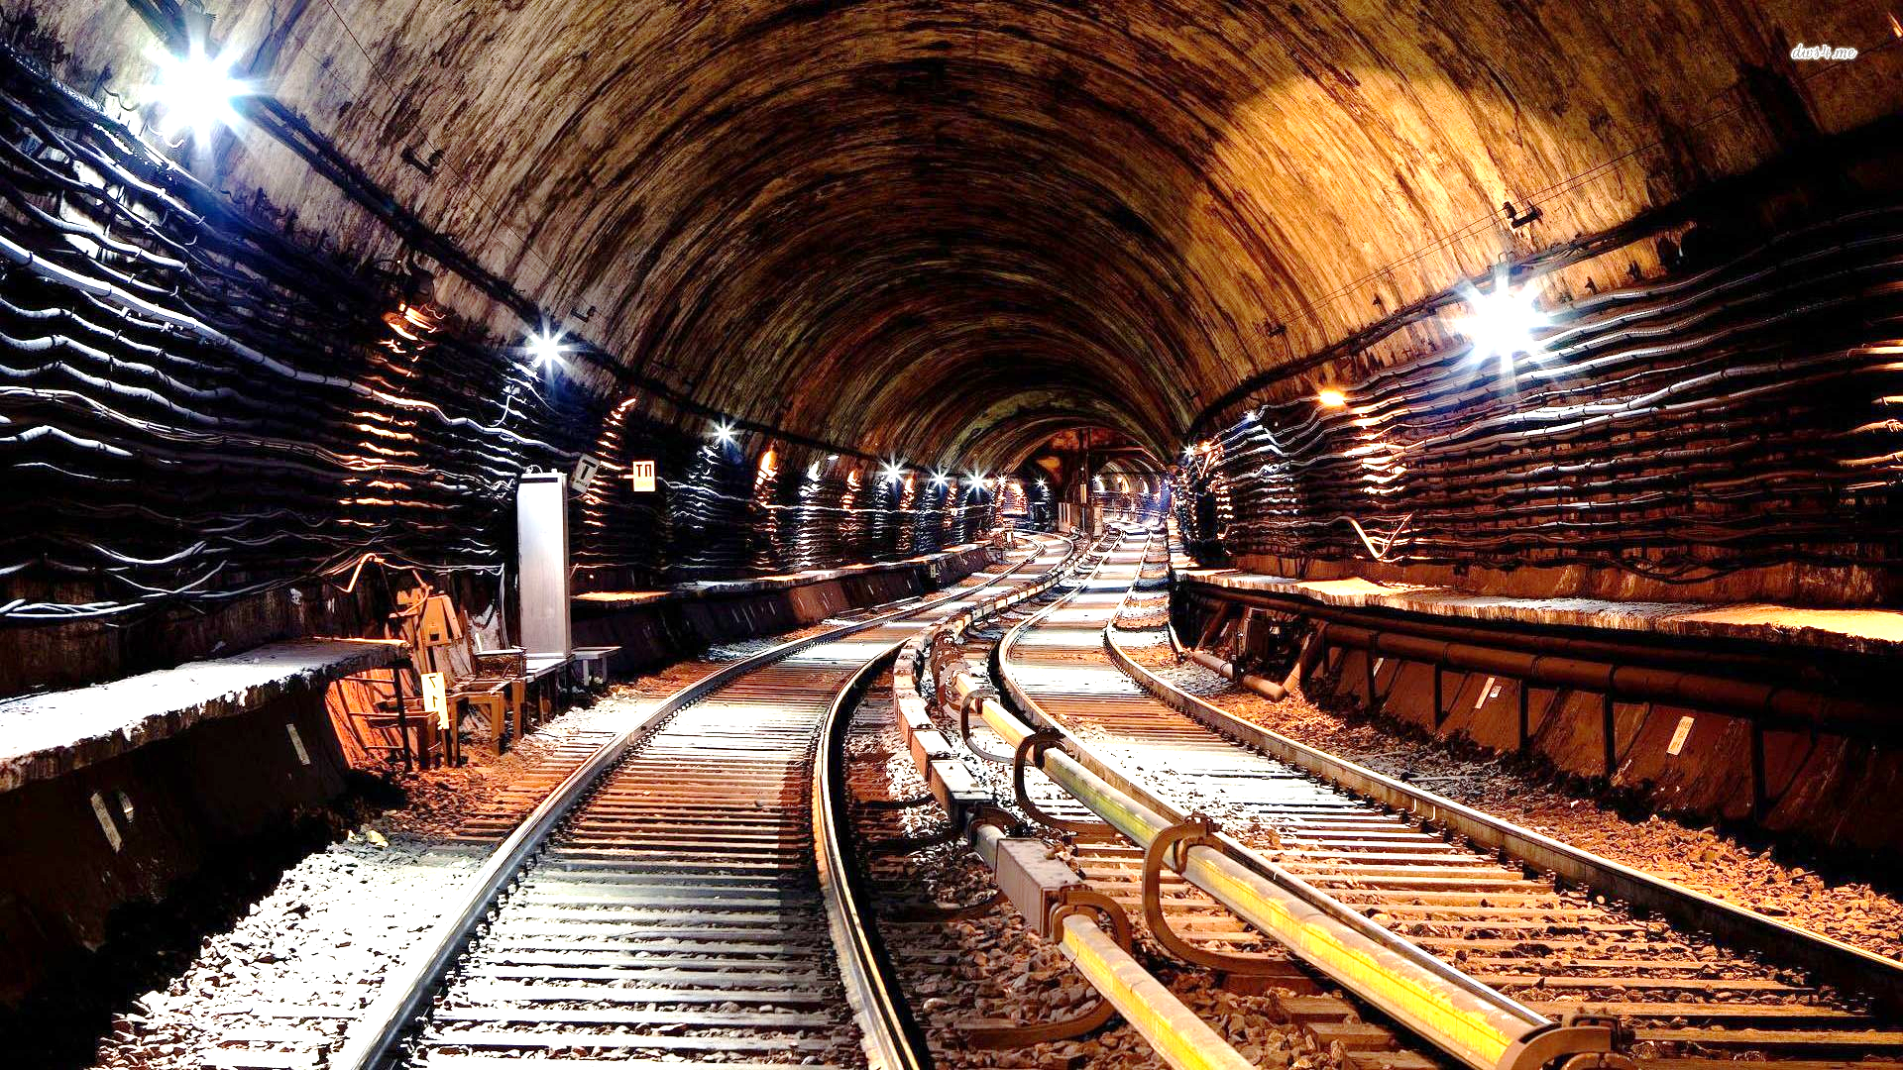
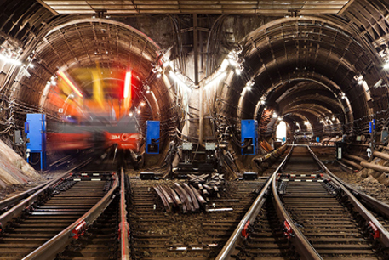
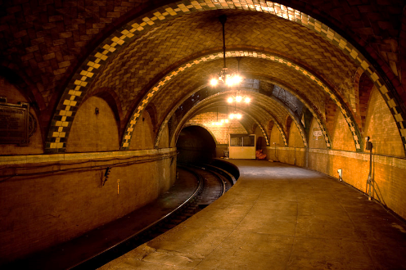
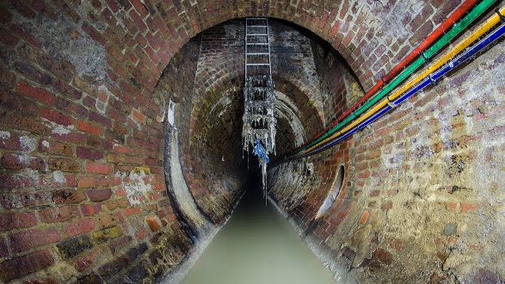
Accessibility
Resilience
Intersection of the Built, Natural, and Human Systems
Below grade systems
Livability (Quality-of-Life) and Resilience Systems: Environment, Climate, Economy, History and Culture, Governance Coordination, Public Health, Public Safety, Public Perception, Education, Civic Engagement, Transportation and Mobility, Housing, Diversity, Recreation, Entertainment, Economic and Social Opportunity, Tolerance, Accessibility, Water and Materials Resources, Transportation and Mobility, Civic Engagement 1, 2, 3
Regional - Delaware Valley Regional Planning Commission (MPO), Marcellus Shale Coalition, I-95 Corridor Coalition, South East Pennsylvania Transit Authority (SEPTA), Delaware River Port Authority, PHL Airport, Public Utility Commissions, Power Generation and Distribution
Emergency Responders / Emergency Management - Pennsylvania Emergency Management Agency, State and Local Police, Fire Department, Emergency Medical Services (EMS), Towing companies
Federal Government – FHWA, FRA, NHTSA, FAA, EPA, USGS, US Army Corps of Engineers, US Coast Guard, AMTRAK (Quasi-Gov.)
State Government - Governor’s Office, State Legislators, Pennsylvania Department of Environmental Protection, PennDOT, Pennsylvania Turnpike Commission, Pennsylvania’s State Police, Parking Authorities
City Government - Mayor’s Office, City Council, Philadelphia Planning Commission, Department of Streets, Water Department, Philadelphia Gas Works, License and Inspection, Fairmount Park, Parks and Recreation, Bike Share
Local/Community - Committee of Highway Supervisors, Property Owners, Developers, Economic Development Groups, Philadelphia Historical Commission, Tourism Groups (VisitPhiladelphia), Carpooling/Ride Share organizations, The General Public
Private Sector – Railroad Companies, Comcast, Colleges, Rental Car/Zipcar®, Contractors, Hospitals, Fuel-Energy Transport/Storage/Distribution
USERS
INSTITUTES
INSTITUTIONS
ORGANIZATION
Regulations: Laws, Executive Orders, Permitting, Clean Water Act, Clean Air Act, Fast Act, NBIS, etc..

